Slide 1



CGEM: A CEREBRAL BLOOD FLOW BASED COMPUTER MODEL OF GZ-INDUCED EFFECTS
Federal Aviation
Administration
AsMA 2021
Kyle Copeland* and James Whinnery (Ret.)
Aerospace Medical Research Division
FAA Civil Aerospace Medical Institute
1 September 2021
*Presenting

Slide 2
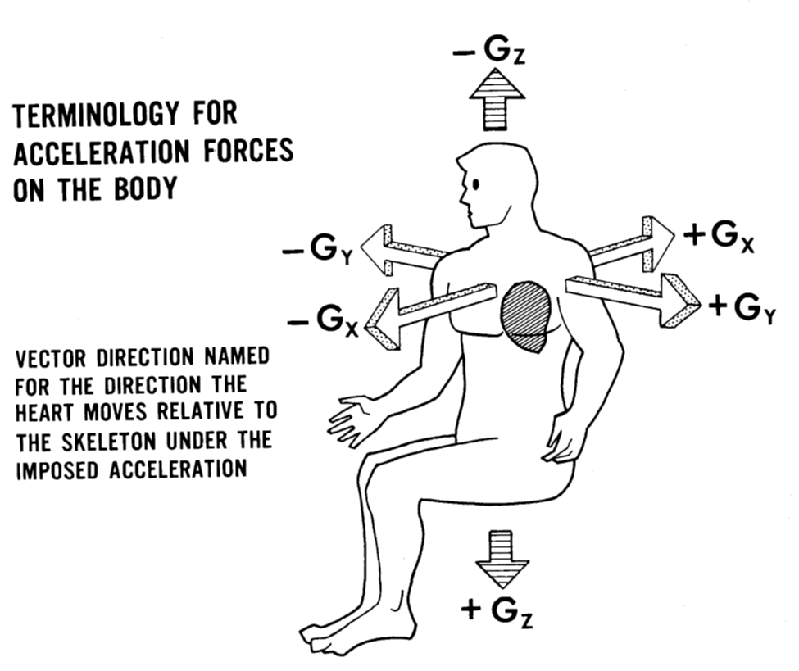

Acceleration (G) effects are an important consideration in civil and military aviation because G-induced loss of consciousness (G-LOC), impaired consciousness, and visual effects all have the potential to result in aviation accidents.
BACKGROUND
2

Slide 3
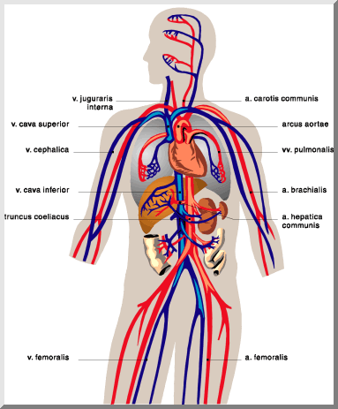
During high positive and negative Gz exposures, the body has difficulty moving blood through tissues at elevations significantly above or below the heart. Brain and eye function can be affected. If the onset is slow enough, visual warning symptoms occur in time to take action before GLOC. As early as WWI pilots had learned to recognize visual symptoms as a warning to avoid GLOC.
BACKGROUND II
3

Slide 4
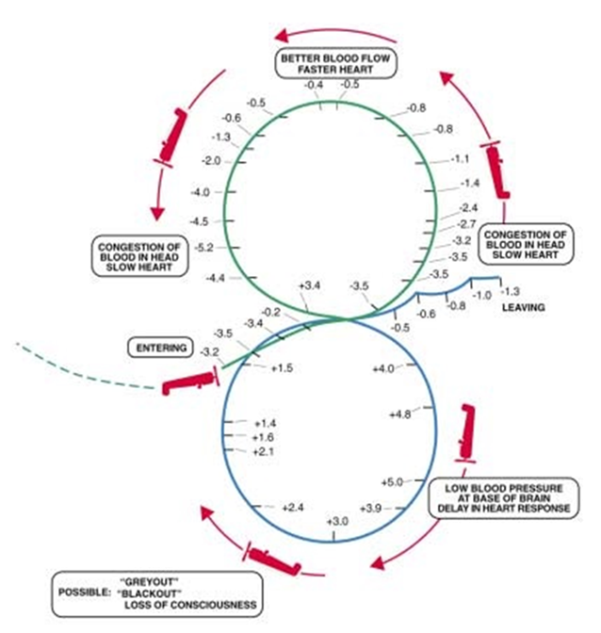
10-year average is about 7 incidents related to GLOC per year according to Air Force Safety Center Many factors affect susceptibility beyond individual physiology The modern anti-GLOC toolkit includes: Targeted muscle straining exercises Pressure breathing gear Suit Recent exposure to high G forces Negative influences: Fatigue Dehydration Hyperthermia Medications
BACKGROUND III
(CASA, 2001)
4

Slide 5
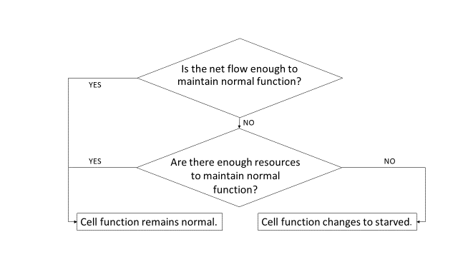
CGEM BASICS
The Civil Aerospace Medical Institute G-Effects Model (CGEM) is a physics and physiology based model that tracks resource flow and use in target cell groups.
Basic assumptions:
Oxygen flow is a suitable proxy for cell supply flow
Cells require a certain amount of resource flow per unit time to maintain normal function
Cells have a metabolic reserve to draw upon temporarily if supply flow is reduced or interrupted
When the reserve is exhausted, a cell converts to a “survival mode” state until conditions improve or it dies
.
Grayout, peripheral light loss, and blackout occur because of inadequate flow at the retina (i.e., retinal ischemia). Intraocular pressure must be overcome by local arterial pressure to prevent visual symptoms.

Slide 6
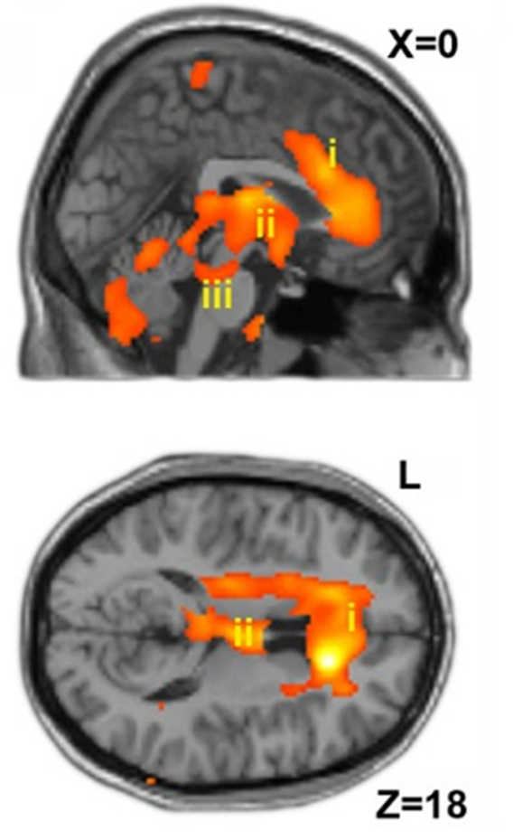
CONSCIOUSNESS
As blood flow through various parts of the brain and eyes slows, cell reserves can empty and functions can be lost, leading to A-LOC, G-LOC, etc.
While there are multiple centers of the brain involved in consciousness, for modeling cerebral blood flow the center of consciousness in the brain was selected to be located halfway between the base of the brain and the center of mass of the eye.
After G-LOC, brain cells must restore cellular reserves before resuming useful consciousness.

Slide 7
GCEM FEATURES
Simulated Experimental Participants
Physiology is defined using 12 parameters
The user can choose one of six predefined physiologies
3 males (normal low, normal, normal high)
3 females (normal low, normal, normal high)
--OR--
choose the parameter values*
Predefined physiologies span a large range of physiologically normal people that are of acceptable height to be U.S. fighter pilots.
Simulation options
The user can choose any of three simulation options:
a series of simulations with acceleration profiles similar to historical centrifuge experiments,
a single simulation of a centrifuge experiment, or
a flight-like simulation, with all aspects of the acceleration profile defined by the user in an external file.
Countermeasures
7 parameters specify details of muscle straining, PBG use, seat tilt, suit pressure and suit coverage.
*Pharmaceutical effect and abnormal conditions can be modeled by adjustments

Slide 8
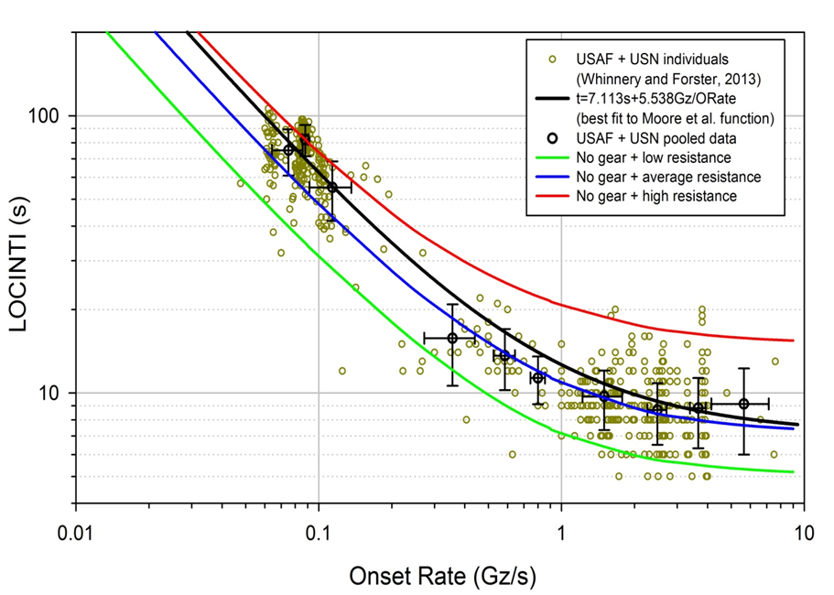
RESULTS: GLOC Onset

Slide 9
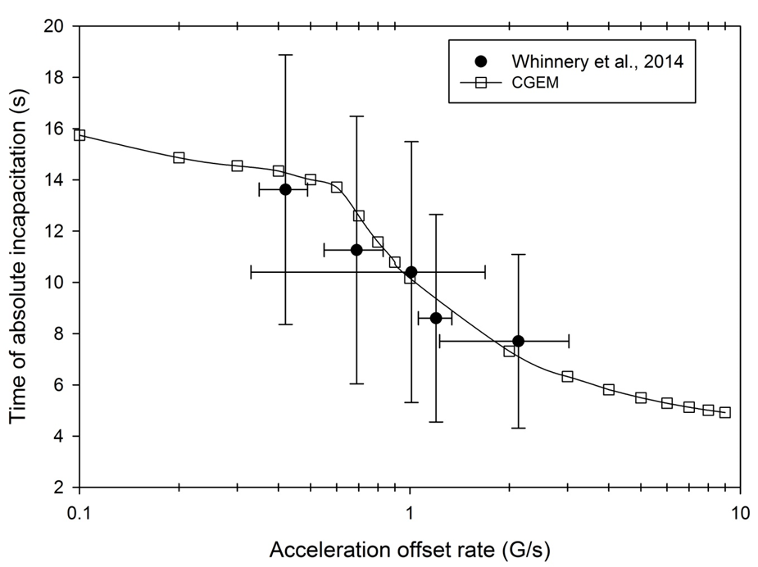

RESULTS: Duration of Absolute Incapacitation
9

Slide 10
RESULTS: Countermeasures
Countermeasure | Gradual onset tolerance, +Gz |  | Rapid onset tolerance, +Gz
 | Measured | CGEM | Measured | CGEM
None ^{A} | --- | --- | 3.4 | 4.2
Gripping ^{B,C} | 5.6 | 5.9 | 4.5 | 4.4
Suit ^{B,D} | 4.7, 5.7, 5.9, 6.9 | 5.3, 5.6, 5.7, 5.9 | 4.7, 5.0, 5.9 | 5.2, 5.3, 5.5
Suit ^{A} | --- | --- | 6.5 | 6.5
Suit ^{B,E} | 6.7 | 6.8 | 5.6 | 6.8
Suit ^{B,F}+ gripping ^{B,C} | 6.2 | 7.5 | 5.4 | 5.7
AGSM ^{B} | --- | 7.2 | --- | 6.8
Suit ^{B,G}+ AGSM ^{B} | --- | 9.2, 9.5 | 9.0, 10.7 | 8.6, 8.9
Suit ^{B,H}+ PBG ^{B} | --- | 8.7, 10.2 | 7.8, 8.8 | 8.5, 9.9
Suit ^{B,I}+ AGSM ^{B}+ PBG ^{B} | --- | 10.6 | 11.0 | 10.4
^{A} Measurement data from Eikken et al. (2007). Calculations are for average resistance male except height altered to 181 cm to match the study participant mean. When present suit pressure limited to 10 psi. ^{B} Measurement data are as summarized by Burton (2000), Calculations are for an average resistance male, except subject height altered to match data source, by requiring a 35 cm heart-eye distance when standing. ^{C} CGEM tensing effect set at 50 mmHg and limited to maximum increase of 50 mmHg in 30 seconds (no ramp, all pre-event tensing). ^{D} For gradual onset, inflations were limited to 4.1, 5.6, 6.0, and 7.5 psi, respectively. For rapid onset, suit inflations used were 4.1, 4.5, and 5.9 psi, respectively. ^{E} Larger coverage suit, >50%, 5.3 psi. ^{F} For gradual onset suit inflated to 5.1 psi, for rapid onset inflation limited to 6.3 psi. ^{G} Suit inflations of 10 and 12 psi. ^{H} Gradual onset suit inflation of 10.7 psi and rapid onset suit inflation of 9.5 psi, each with suits of 30% and 70% coverage. ^{I} Suit inflation 12 psi.
10

Slide 11
SAFETY: Safety of Aerobatics
Safety evaluation of aerobatic maneuvers based on CGEM calculations for relaxed average resistance male and female participants.
Maneuver | Acceleration extremes, Gz | Minimum seconds from G-LOC (M / F) | Minimum seconds from black out (M / F) | Visual symptoms (M / F)
Outside 360 | 1.0, -2.2 | 7.1 / 7.1 | 5.0 / 5.0 | No / No
Horizontal rolling 360 | 3.2, -3.0 | 7.1 / 7.1 | 5.0 / 5.0 | No / No
Hammerhead | 4.2, -0.4 | 7.1 / 7.1 | 5.0 / 4.6 | No / No
Snap 45 down roll | 4.8, -0.8 | 7.1 / 7.1 | 4.7 / 4.8 | No / No
Quarter down roll | 4.7, -1.4 | 6.9 / 7.0 | 4.3 / 4.4 | No / No
Half-vertical roll with negative pullout | 4.8, -3.0 | 6.1 / 7.0 | 2.1 / 1.8 | No / No
Outside-inside vertical 8 | 6.0, -4.2 | 2.0 / 2.9 | 0.0 / 0.0 | Yes / Yes
11

Slide 12
SAFETY: Medication and Other Effects
Effects of medications and other influences, such as severe dehydration, can be included in the model by altering subject characteristics. The table shows influences on G tolerances in the CGEM model due to:
a heart response delay of 3 seconds induced by use of a beta-blocker
lowered max BP from mild dehydration or mild hyperthermia
combined mild dehydration and mild hyperthermia
50% loss of effectiveness due to fatigue during AGSM
combined fatigue, mild dehydration and mild hyperthermia.
Influence | G tolerance, rapid onset | G tolerance, gradual onset
None | 7.1 | 7.5
Cardiac response delay of 3 s | 6.0 | 7.5
Mild dehydration or mild hyperthermia | 7.0 | 7.4
Mild dehydration + mild hyperthermia | 6.8 | 7.2
Fatigue | 5.8 | 6.1
Fatigue + m. dehy.+ m. hypertherm. | 5.5 | 5.8

Slide 13
Concluding Remarks
CAMI has developed a physics and physiology based model of Gz effects in airmen for aviation accident assessment and may also be used by pilots and flight surgeons to estimate the physiological difficulty of planned aerobatic maneuver sequences
Blood flow and usefulness at target sites are tracked to calculate expected symptoms in airmen
CGEM accurately predicts GLOC onset, period of incapacitation, and visual symptom onset during centrifuge experiments and user-defined specific aerial maneuvers--predicted times to G-LOC and absolute incapacitation periods were consistently within one standard deviation of pooled results obtained during centrifuge experiments using USN and USAF pilots
Results support the conclusion drawn from earlier studies that the current warning attached to Federal Aviation Administration special issuance waivers for cardiac disease is sufficient
The software will be released through the CAMI Physiology Research Team Website: https://www.faa.gov/data_research/research/med_humanfacs/aeromedical/environmentalphysiology/
13

Slide 14
BIBLIOGRAPHY
Burton, R.R. (2000). Mathematical models for predicting G-level tolerances. Aviation, Space, and Environmental Medicine, 71, 506–13.
Civil Aviation Safety Authority Australia (2001). Guidelines for Aerobatics (AC91-075(0)).
Eiken. O., Ölgård R., Bergsten, E., Grönkvist, M. (2007). G protection: interaction of straining maneuvers and positive pressure breathing. Aviation, Space, and Environmental Medicine, 78, 392–8.
Moore, T.W., Jaron D., Hrebien, L., Bender, D. (1993). A mathematical model of G time-tolerance. Aviation, Space, and Environmental Medicine, 64, 947–51.
Whinnery, T., and Forster, E.M. (2013). The +Gz-induced loss of consciousness curve. Extreme Physiology and Medicine, 2, 19.
Whinnery, T., Forster, E.M., Rogers, P.B. (2014). The +Gz recovery of consciousness curve. Extreme Physiology and Medicine, 3, 9 (avail from www.extremephysiolmed.com/content/3/1/9).

Slide 15
Thank you for your attention.
Questions?
E-mail: kyle.copeland@faa.gov
15

